Slide 1
Style Transfer for Anime Sketches with Enhanced Residual U-net and Auxiliary Classifier GAN

Slide 2
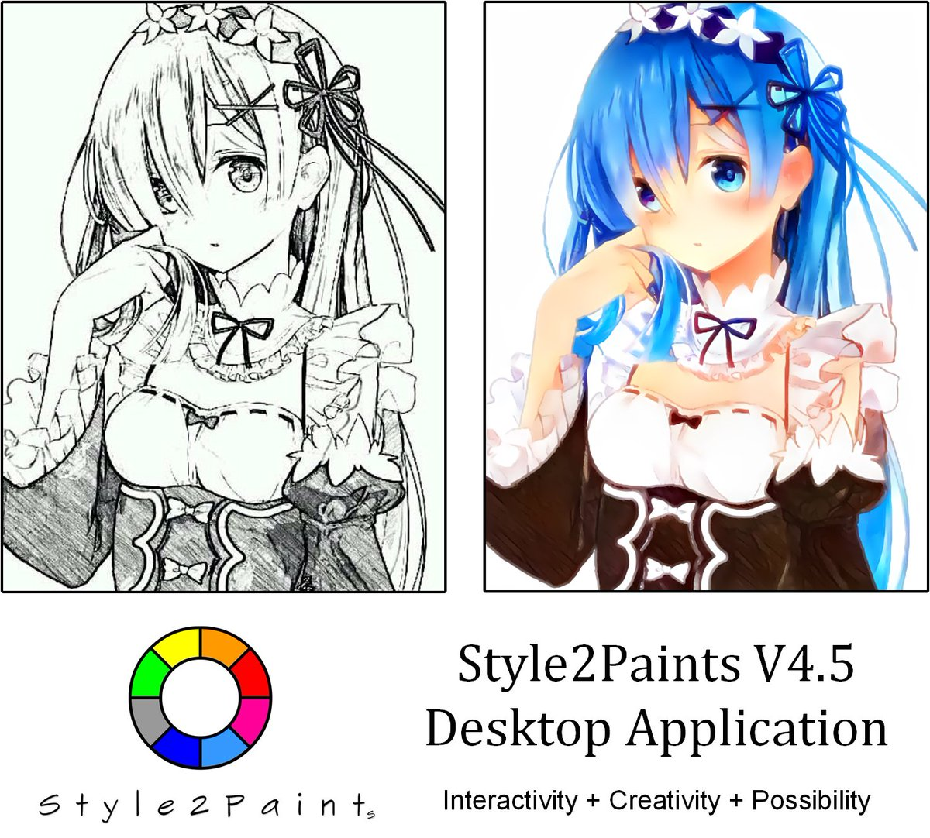

Slide 3
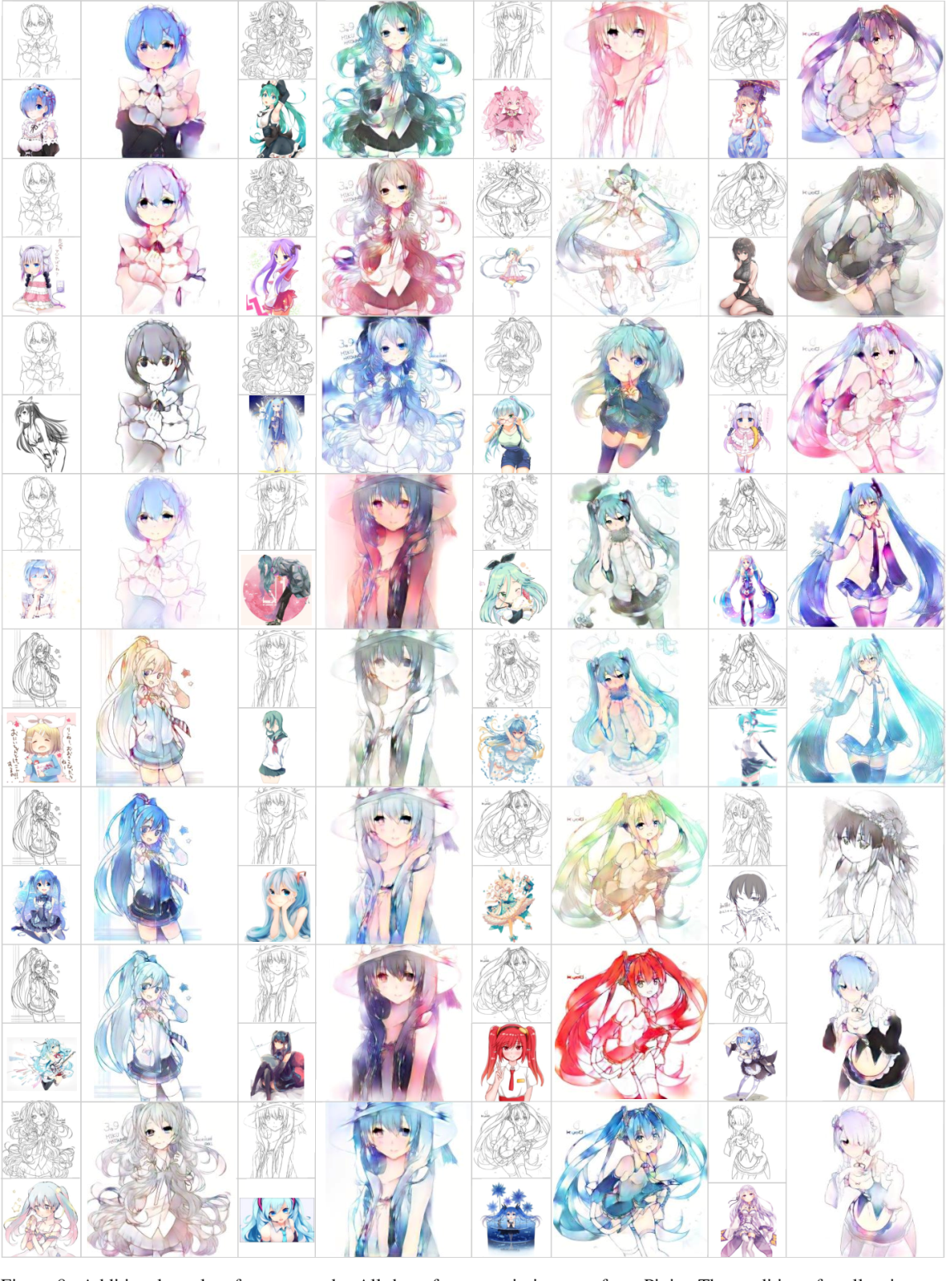

Slide 4
GAN

Slide 5
Generative Adversarial NetworkS
Created in 2014 by Ian Goodfellow
Semi-supervised learning
Used in Image / audio synthesis

Slide 6
Why is it Adversarial ?

Slide 7
2 components :
Generator : Replicate real data to produce fake data
Discriminator : Distinguishes real data from fake data

Slide 8
Steps to train a GAN :
Define the problem
Define GAN Architecture
Train Discriminator to distinguish “real” vs “fake” data
Train Generator synthesize data
Repeat steps 3 and 4 for N times

Slide 9
Loss Function
Discriminator is a binary classifier
Cross Entropy Loss :
H( p,q )= - p log(q) – ( 1-p ) log( 1-q )
Half sample from real dataset : x~p_data
Half sample from fake dataset : x~p_generator
D(x) : Predicted output of Discriminator
If D(x) = 0 , data is fake
Or if D(x) = 1 , data is real

Slide 10
Types of GAN :
Conditional GAN
Deep Convolutional GAN
Info GAN
Wasserstein GAN

Slide 11
CGAN

Slide 12
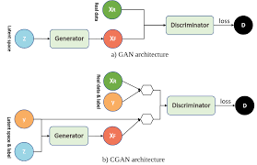
Conditional GAN
Input : Condition
Output : Specific types of output will be generated

Slide 13


Generate a random digit
Randomly
Sampled
Data
GAN
Generator
Randomly
Sampled
Data
CGAN
Generator
2

Slide 14
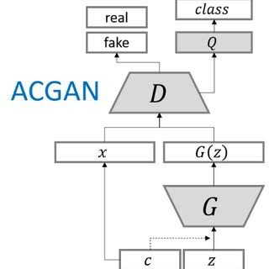
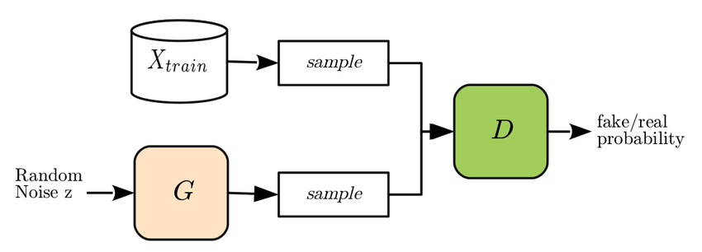

Slide 15
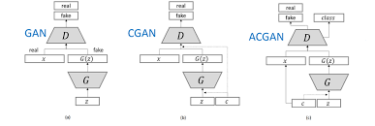

Slide 16
U-Net

Slide 17
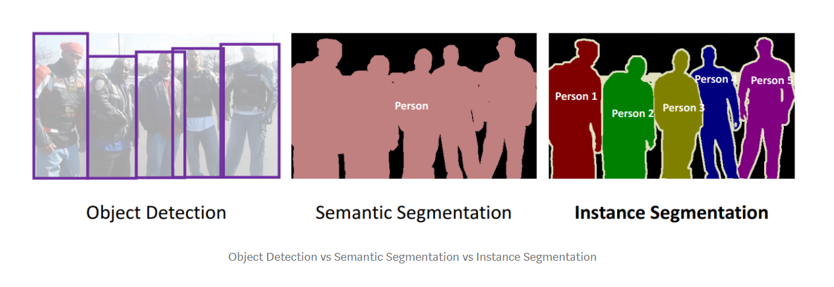

Slide 18
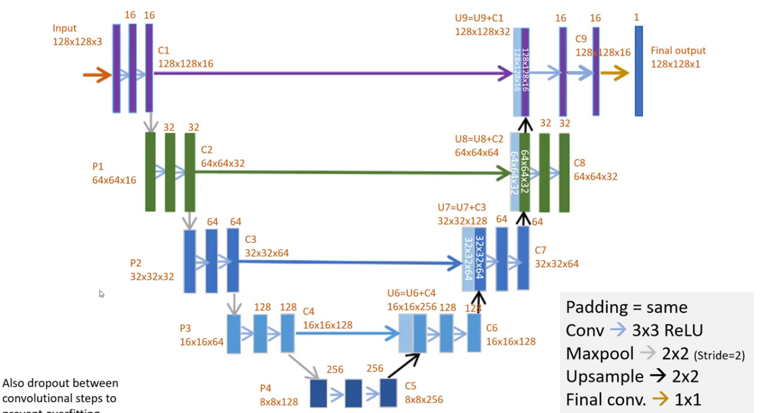
U-NET Architecture

Slide 19
